Slide 1




Intro to Angular
What is Angular
Overview and TypeScript Syntax
Angular
Intro
SoftUni Team
Technical Trainers
Software University
http://softuni.bg

Slide 2



Table of Contents
Angular Overview
Introduction to TypeScript
Angular Installation
Angular CLI
Hello World

Slide 3
Have a Question?
sli.do #angular-js

Slide 4


Angular Overview
What The Fuzz Is All About

Slide 5
What is Angular?
Angular is a framework for building complex front-end apps
Focused on end-to-end tooling and best practices
Developed by the Angular team at Google
import { Component } from '@angular/core';
@Component({
selector: 'my-app',
template: `<h1>Hello {{name}}</h1>`
})
export class AppComponent { name = 'Angular'; }

Slide 6


Features
Easy to learn
Modern codebase
Component-based
Uses TypeScript
IDE friendly
Performance oriented
Mobile first
Solid community
Backed by Google
MVC pattern
Good flexibility
Dependency injection
Saves a lot of time
Effective data binding

Slide 7

Introduction To TypeScript
A JavaScript Superset

Slide 8
Introduction To TypeScript
Install globally via npm
TypeScript uses the .ts file extension (supported by VS Code)
To compile your code
Compilation output is plain JavaScript
npm install -g typescript
tsc myfile.ts

Slide 9
Introduction To TypeScript
class Student {
fullName: string;
constructor(public firstName: string,
public middleInitial: string,
public lastName: string) {
this.fullName = firstName + " " + middleInitial + " " + lastName;
}
}
interface Person {
firstName: string;
lastName: string;
}
function greeter(person : Person) {
return "Hello, " + person.firstName + " " + person.lastName;
}
document.body.innerHTML = greeter(new Student("Jane", "M.", "User"));

Slide 10
Variable Types
let isDone: boolean = false;
let decimal: number = 6;
let hex: number = 0xf00d;
let binary: number = 0b1010;
let octal: number = 0o744;
let color: string = "blue";
color = 'red';
let list: number[] = [1, 2, 3];
let list: Array<number> = [1, 2, 3];
More info at typescriptlang.org/docs/handbook/basic-types.html

Slide 11
Interfaces
Property assertion
function printLabel(labelledObj: { label: string }) {
console.log(labelledObj.label);
}
let myObj = {size: 10, label: "Size 10 Object"};
printLabel(myObj);
interface LabelledValue {
label: string;
}
function printLabel(labelledObj: LabelledValue) { … }

Slide 12
Generics and Enumerations
function identity<T>(arg: T): T {
return arg;
}
let output = identity<string>("myString");
// type of output will be 'string'
let output = identity(5);
// type of output will be 'number'
Type inference
enum Direction {
Up = 1,
Down,
Left,
Right,
}

Slide 13
Modules
export default interface StringValidator {
isAcceptable(s: string): boolean;
}
export { ZipCodeValidator };
export { ZipCodeValidator as mainValidator };
import { ZipCodeValidator } from "./ZipCodeValidator";
import * as validator from "./ZipCodeValidator";
import num from "./OneTwoThree";

Slide 14



Angular Installation
Packages, Setup, Structure

Slide 15
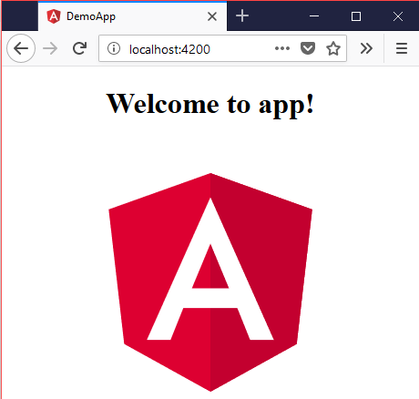
Creating A New App
Install globally via npm
Create new project
Start a dev server on port 4200
npm install -g @angular/cli
ng new some-app
cd some-app
npm install
ng serve

Slide 16
Finding Information
Visit the official website
Documentation
Online sandbox
https://angular.io/
https://angular.io/docs
embed.plnkr.co/?show=preview&show=app%2Fapp.component.ts

Slide 17



IDE Support
Visual Studio Code fully supports TypeScript
You may use your favorite IDE (most have plugins)
By using the Angular CLI
You do not need to use a linter
You do not need install any specific plugin
Everything is included

Slide 18

Let's Hack Some Code
A simple Hello World!

Slide 19

Summary
Angular is a framework for front-end apps
TypeScript is JavaScript superset language
The Angular CLI is a complete toolkit for working with Angular
interface LabelledValue {
label: string;
}
function print(labelledObj: LabelledValue) { … }

Slide 20







JavaScript Web – Angular Fundamentals
https://softuni.bg/courses/

Slide 21
License
This course (slides, examples, demos, videos, homework, etc.) is licensed under the "Creative Commons Attribution-NonCommercial-ShareAlike 4.0 International" license
Attribution: this work may contain portions from
"End-to-end JavaScript Applications" course by Telerik Academy under CC-BY-NC-SA license

Slide 22





Trainings @ Software University (SoftUni)
Software University – High-Quality Education, Profession and Job for Software Developers
softuni.bg
Software University Foundation
http://softuni.foundation/
Software University @ Facebook
facebook.com/SoftwareUniversity
Software University Forums
forum.softuni.bg

